Slide 1

Bank Loan Prediction Engine
A Logistic Regression approach to streamlining credit risk and loan approval processes.

Slide 2
01. The Economic Catalyst
"Banks play an important role in spurring the economy, preventing economic recessions, and greasing the wheels of industry."

Slide 3

Project Overview & Objectives
Data Acquisition
Primary Goal
Leveraging a Kaggle dataset comprising demographics from over 500 borrowers to identify key lending patterns.
Automate the classification of loan status (Approved vs. Denied) to reduce manual capital acquisition barriers.

Slide 4

Core Feature Dictionary
Feature Name | Description | Impact Type
Total_Income | Combined annual earnings of the borrower | Numerical
LoanAmount | Requested principal amount ($'000) | Numerical
Credit_History | Past repayment records (Binary: 0 or 1) | Categorical
Education | Graduate or Undergrad status | Categorical
Married / Gender | Demographic identifiers | Categorical
Self_Employed | Employment status of the applicant | Categorical
*There are 2 more features

Slide 5


Methodology: Logistic Regression
Binary Classification
Logistic Regression is a classification algorithm that predicts a categorical outcome based on input features.
•
Inputs: Demographics and financial features.
•
Weights: The model adjusts weight values during training to maximize predictive accuracy.
•
Outcome: A discrete "Approved" or "Denied" decision.

Slide 6


Data Processing & Integrity
Clean Data Foundation
The Kaggle dataset features ~500 borrowers with diverse demographics including Property Area and Employment.
Efficiency: Since the source was already in a structured format, the model focused directly on the 8 most predictive features without extensive pre-processing.

Slide 7
Experimental Design
75% Training Set
25% Testing Set
8 Key Features
Strategic splitting ensures the model generalizes well to unseen borrower profiles within the existing data scale.

Slide 8
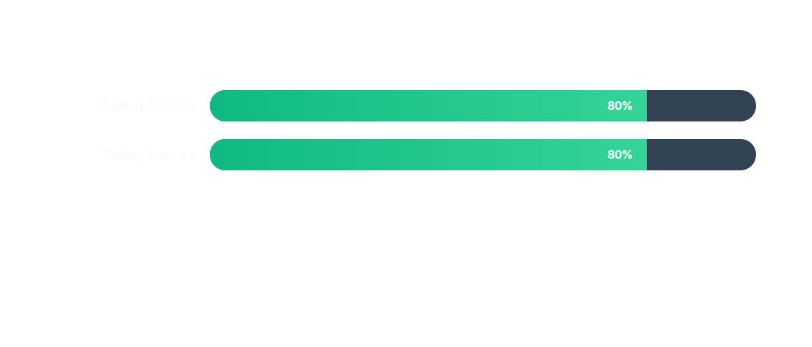
Predictive Performance
The model demonstrates consistency across both training and testing datasets, maintaining an ~80% success rate in predicting loan outcomes.

Slide 9

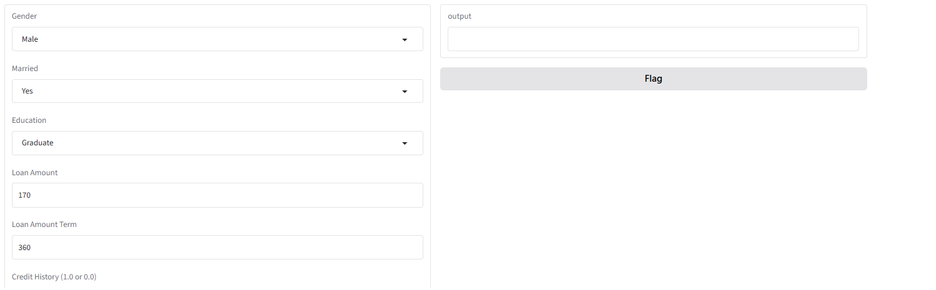



GUI & User Interaction
Input Interface
Real-time Output
User-friendly entry for numerical and categorical borrower data.
Immediate classification feedback (Accepted/Rejected) displayed via GUI.

Slide 10
Future Direction
Exploring advanced algorithms (Random Forest, XGBoost) and larger datasets to further enhance accuracy and eliminate scale-based input issues.

Slide 11

Questions & Feedback
Thank you for exploring the Bank Loan Prediction Engine.
Notes:
github: https://github.com/aadhavjawahar-sys/Bank_Loan_Prediction/tree/main

Slide 12



Image Sources
https://www.libertybank.com/wp-content/uploads/2025/07/happy-couple-with-their-mortgage-broker.jpg
Source: www.libertybank.com
https://static.vecteezy.com/system/resources/previews/077/090/505/non_2x/binary-code-0-1-data-stream-abstract-technology-background-vector.jpg
Source: www.vecteezy.com
https://static.vecteezy.com/system/resources/thumbnails/070/636/398/small/responsive-website-design-mockup-on-multiple-devices-computer-laptop-tablet-and-smartphone-displaying-modern-interface-photo.jpeg
Source: www.vecteezy.com

